Slide 1
EDA ON EMPLOYEE ATTRITION
Submitted By:
Himanshu Yadav (D22018)
Prakhar Trivedi (D22034)
Pranav Tyagi (D22035)
Submitted To:
Prof. Gourab Nath
Colab Link - https://colab.research.google.com/drive/1M1N1ZVuCFgWrbUB5bgD_e-DFG04gWT1Y?usp=sharing

Slide 2
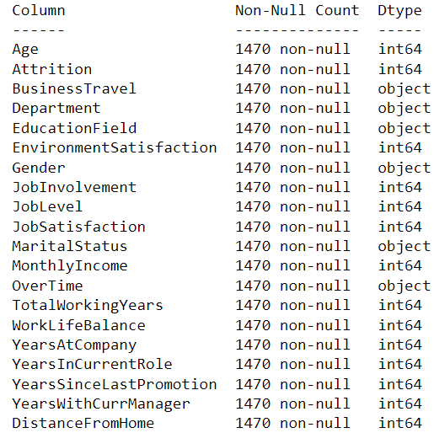

Data Overview
Total Rows | Total Columns
1470 | 20
Nominal | Ratio | Ordinal
Bussiness Travel | Age | Environment Satisfaction
Department | Monthly Income | Job Satisfaction
Education Field | Total Working Years | Work Life Balance
Gender | Years In CurrentRole | Job Level
Marital Status | Years Since Last Promotion | Job Involvement
Over Time | Years WithCurr Manager
Attrition | Distance From Home
 | Years At Company

Slide 3
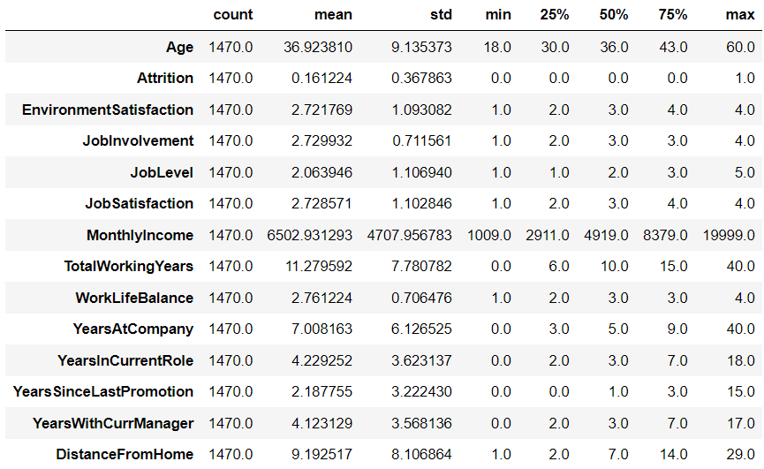
Under our analysis, we found that in this company :
Age is normal distribution.
Environment Satisfaction is normal .
Job Involvement is normal.
Job Satisfaction is normal .
Monthly Income is Chebyshev.
Total WorkingYears is normal.
Work Life Balance is normal.
Years At Company is Chebyshev.
Years In Current Role is Chebyshev.
Years Since Last Promotion is Chebyshev.
Years With CurrManager is Chebyshev.
Distance FromHome is Chebyshev.

Slide 4
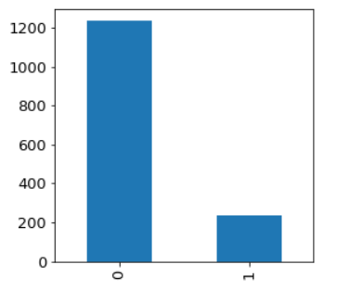
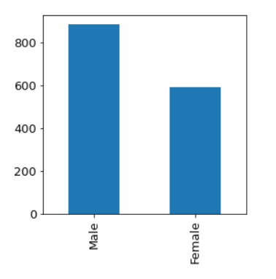
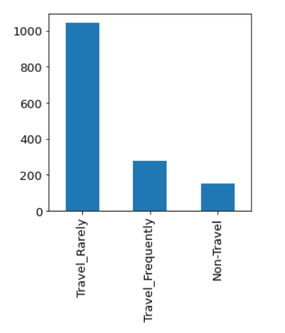
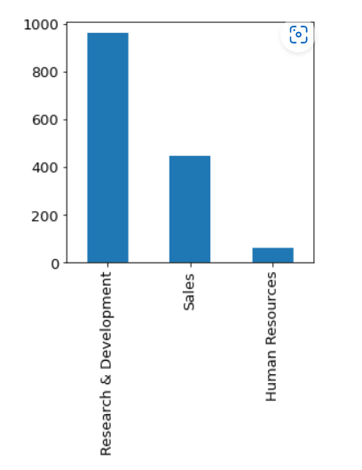
Univariate Analysis
Attrition
Gender
Business Travel
Department
Under our analysis :
In this company we have found out of total employees 237 employees has been done attrition and rest are still in the company.
In this company we have found that out of total employees 588 are females and 882 are males.
In this company we have found that out of total employees 150 are non- travelers, 277 are Travel frequently and 1043 travel rarely.
In this company we have found that out of total employees 64 are in human resources, 961 are in Research and development and 446 in sales

Slide 5
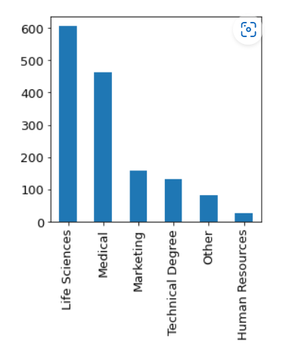
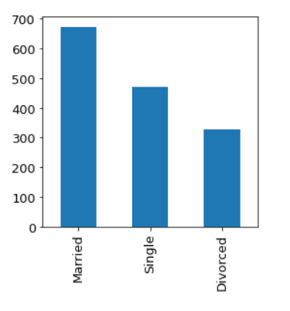
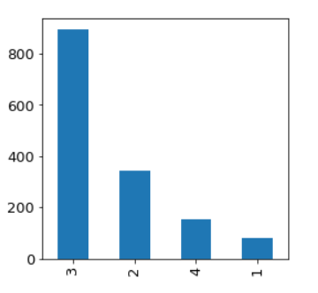
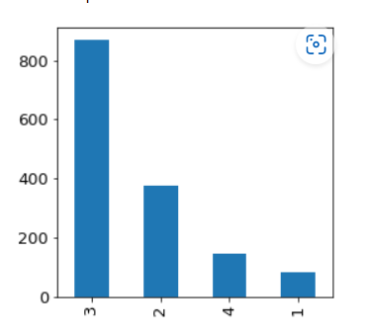
Education Field
Marital Status
Job Involvement
Work Life Balance
Under our analysis :
In this company we have found that out of total employees 27 are from human resources,606 from life sciences, 159 from marketing, 464 from medical, from others 82, from technical degrees 132
In this company we have found that out of total employees 327 are divorced, 673 are Married, 470 are single.
In this company we have found that out of total employees 83 people has job involvement 1, 375 has 2, 868 has 3, 144 has 4.
In this company we have found that there are 80 employees which have given rating 1 in work life balance 344 have given rating 2 , 893 given rating 3 and 153 given rating 4

Slide 6
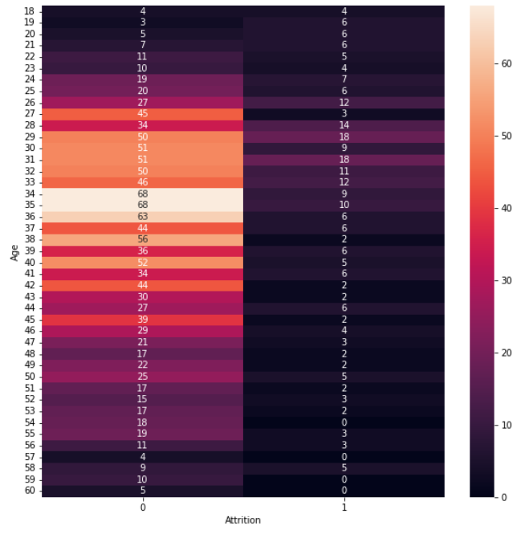
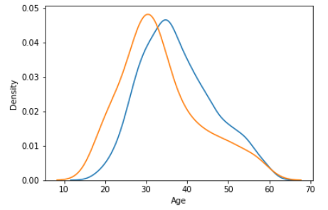
Bivariate Analysis
Age vs Attrition
Frequency
Probability
= 1
= 0
Under our analysis we have found that in this company:
Maximum attrition happens between age 25-35.
Probability of leaving Company to staying in company is relatively higher between age 20-35.

Slide 7
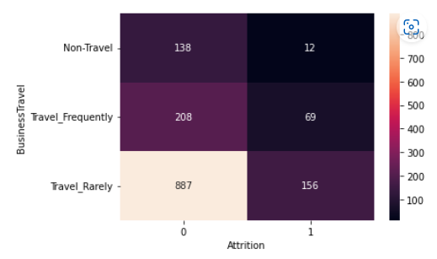
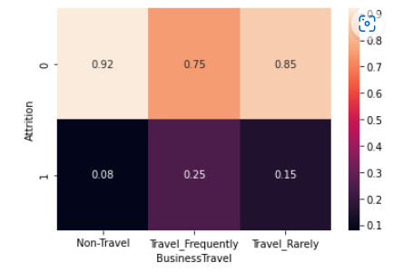
Business Travel vs Attrition
Frequency
Probability
Under our analysis we have found that in this company :
Maximum attrition happens when employees travel rarely.
0.25 is the highest probability of employees leaving who travel Frequently.

Slide 8
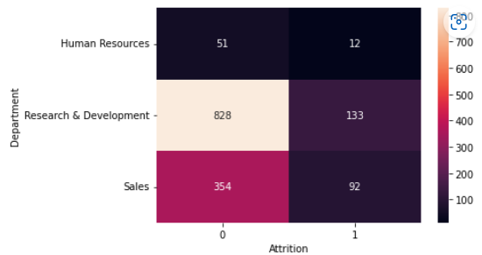
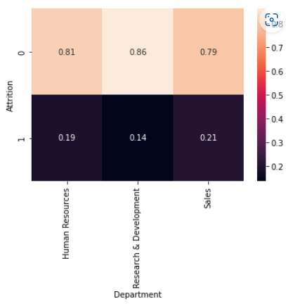
Department vs Attrition
Frequency
Probability
Under our analysis we have found that in this company:
Maximum attrition happens from Research & Development.
Given Sales Department 0.21 is the probability of employees leaving company.

Slide 9
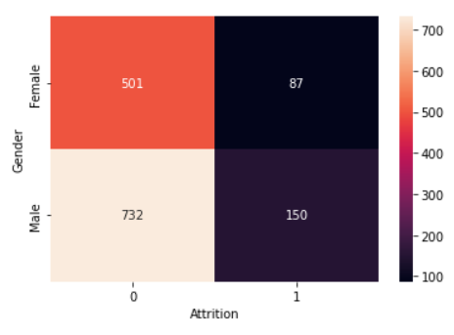
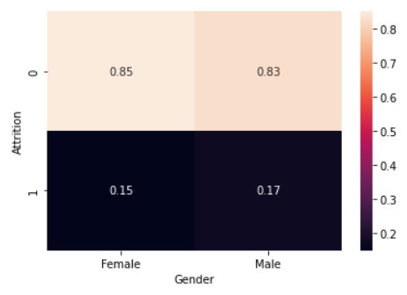
Gender vs Attrition
Frequency
Probability
Under our analysis we have found that:
Maximum attrition done by Males.
Given Males, 0.17 is the probability of employees leaving company.

Slide 10
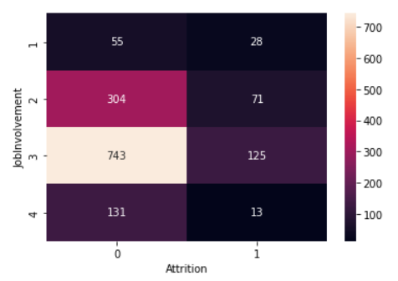
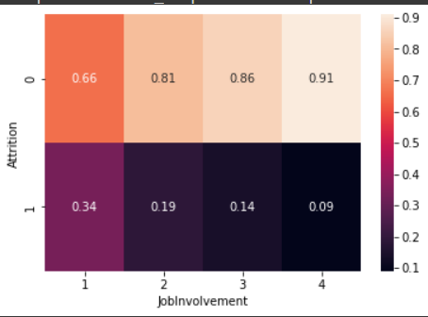
Job Involvement vs Attrition
Frequency
Probability
Under our analysis we have found that in this company :
Maximum attrition happens from Job Involvement Level 3.
Given Job Involvement 1, 0.34 is the probability of employees leaving company.

Slide 11
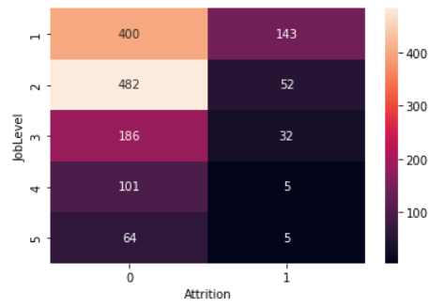
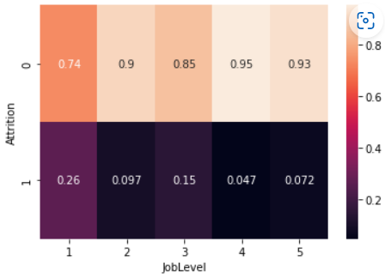
Job Level vs Attrition
Frequency
Probability
Under our analysis we have found that:
Maximum attrition happens from Job Level 1.
Given Job Level 1 , 0.26 is the probability of employees leaving company.

Slide 12
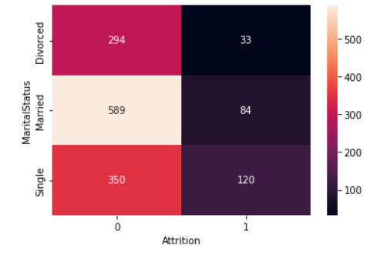
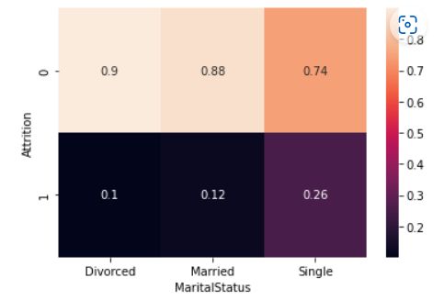
Marital Status vs Attrition
Frequency
Probability
Under our analysis we have found that in this company:
Maximum attrition happens by Single Employees.
Given Singles, 0.26 is the probability of employees leaving company.

Slide 13
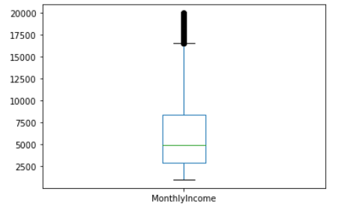
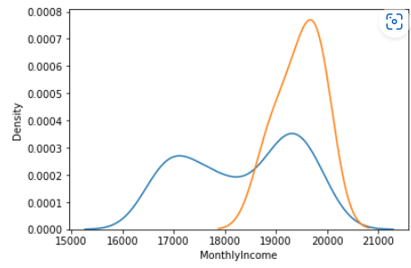
Monthly Income vs Attrition
Frequency
Probability
= 1
= 0
Under our analysis we have found that in this company:
Maximum attrition is being done by Employees when they have very less monthly Income.
Probability of leaving Company to staying in company is relatively higher when monthly income in the range of 18000 to 20500 (after removing the outliers).

Slide 14
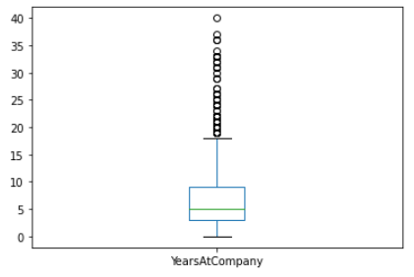
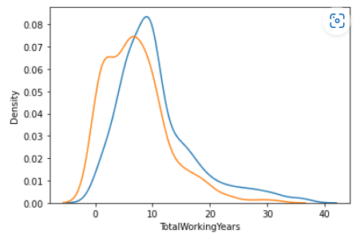
Years At Company vs Attrition
Frequency
Probability
= 1
= 0
Under our analysis we have found that in this company :
More number of employees leave the company who have recently joined.
Probability of leaving Company to staying in company is relatively higher between 0-5 Total Working Years.

Slide 15
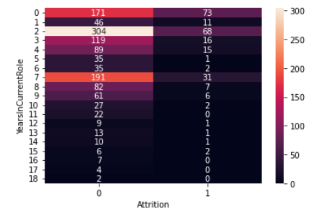
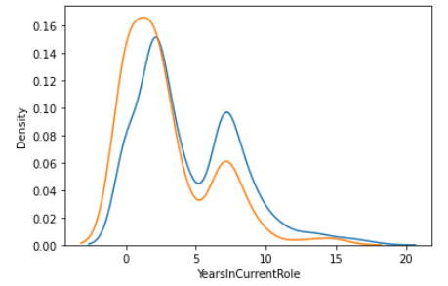
Years In Current Role vs Attrition
Frequency
Probability
= 1
= 0
Under our analysis we have found that in this company:
Maximum attrition happens between 0-2 years in current role . Can also be inferred people who got recently promoted or fresher's who gained 2 years of experience left company.
Probability of leaving Company to staying in company is relatively higher between 0-3 years of experience.

Slide 16
Way Forward…
As per our analysis we have found that 25 to 35 years old employees has maximum chance of leaving the company, so to increase their retention we can give them small hikes in regular interval of time as per their performance , as we know the employees leaving the company has less income as compare to the employee working in the company.
As per our analysis we have found that employee from the Research & Development are doing high attrition and also they travel rarely, so to get their retention management has to arrange their travel to visit companies other offices and arrange some workshops for them where they can indulge themselves into the company.
As per our analysis we have found that female employee are less in company, and maximum attrition performed by the male employees, so to promote gender equality we can hire more females and at the same time this will also help to reduce the employee attrition.
As per our analysis we have found out that employees in lower job level are leaving the company most because they are under paid as compare to employee stayed in the same job level.

Slide 17
Thank You

